Slide 1
Analysis of Ames Housing

Slide 2
Background
I am a working for an Auction House. I have a list of houses that I intend to put up for auction in Ames. I collected the past housing dataset in Ames to research and eventually set a minimum Sale Price of the houses for the auction.

Slide 3
objective
To seek approval to set the baseline price based on the predicted price for the list of houses

Slide 4
Data importing
There are 2 datasets namely test.csv and train.csv
The price column is the target variable
The rest of the variables are the features
There are missing data in both train and test dataset on the numeric fields
I replaced the null values with 0 in both train and test dataset

Slide 5
Data importing
Cleaning of data in raw dataset
Fields | Final Field | Remarks
Bsmt Full Bath, Bsmt Half Bath, Full Bath, Half Bath, | Total Baths | Consolidate all the baths data into one field
Total Bsmt SF, Gr Liv Area, Wood Deck SF, Open Porch SF, Enclosed Porch, 3Ssn Porch, Screen Porch | totalsqft | Sum up all the area in a house
Garage Finish, Garage Yr Blt, Garage Type | has_finished_garage, Detached Garage | transformed the categorical ‘Garage Finish’ column into ‘Has Finished Garage’ and ‘Has Detached Garage’ using one-hot encoding to indicate finished vs unfinished garages. All remaining garage columns were dropped
Year Remod/Add, Year Built | is_remodelled | I introduced a new field to indicate that the house has been remodelled

Slide 6
Data importing
Cleaning of data in raw dataset
Fields | Final Field | Remarks
BsmtFin Type 2, BsmtFin Type 1 | Has Finished Basement | There were multiple categorical columns describing type of basement finish, so I converted these into a one-hot encoded ‘Has Finished Basement’ column
Pool QC | has_pool | ‘Pool QC’ changed to ‘Has Pool’
Fence | has_fence | ‘Fence’ changed to ‘Has Fence’
Paved Drive | has_paved_drive | ‘Paved Drive’ changed to ‘Has Paved Drive’
Central Air | has_central_air | ‘Central Air’ changed to ‘Has Central Air’

Slide 7
Data importing
Cleaning of data in raw dataset
Fields | Final Field | Remarks
Lot Config, MS Zoning, Misc Feature, Neighbourhood, House Style, Bldg Type |  | A number of categorical variables were transformed into dummy column
Bsmt Qual, Bsmt Cond, Fireplace Qu, Heating QC, Garage Qual, Garage Cond, Exter Qual, Exter Cond, Kitchen Qual, Exter Qual, Exter Cond |  | Quality rankings - transforming categorical vairables to ordinal ones
'Year Built’ | age | Turning the 'Year Built' column into 'Age'
Drop all the non numerical fields

Slide 8
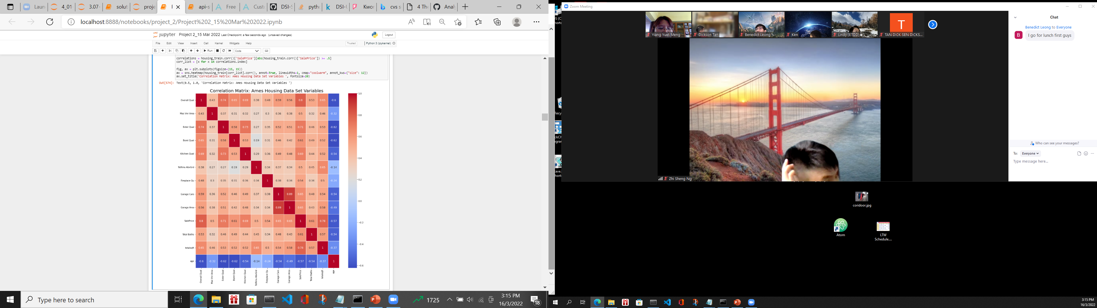
Correlation of predictors
These are the set of predictors with absolute correlation> 0.5 with respect to SalePrice

Slide 9
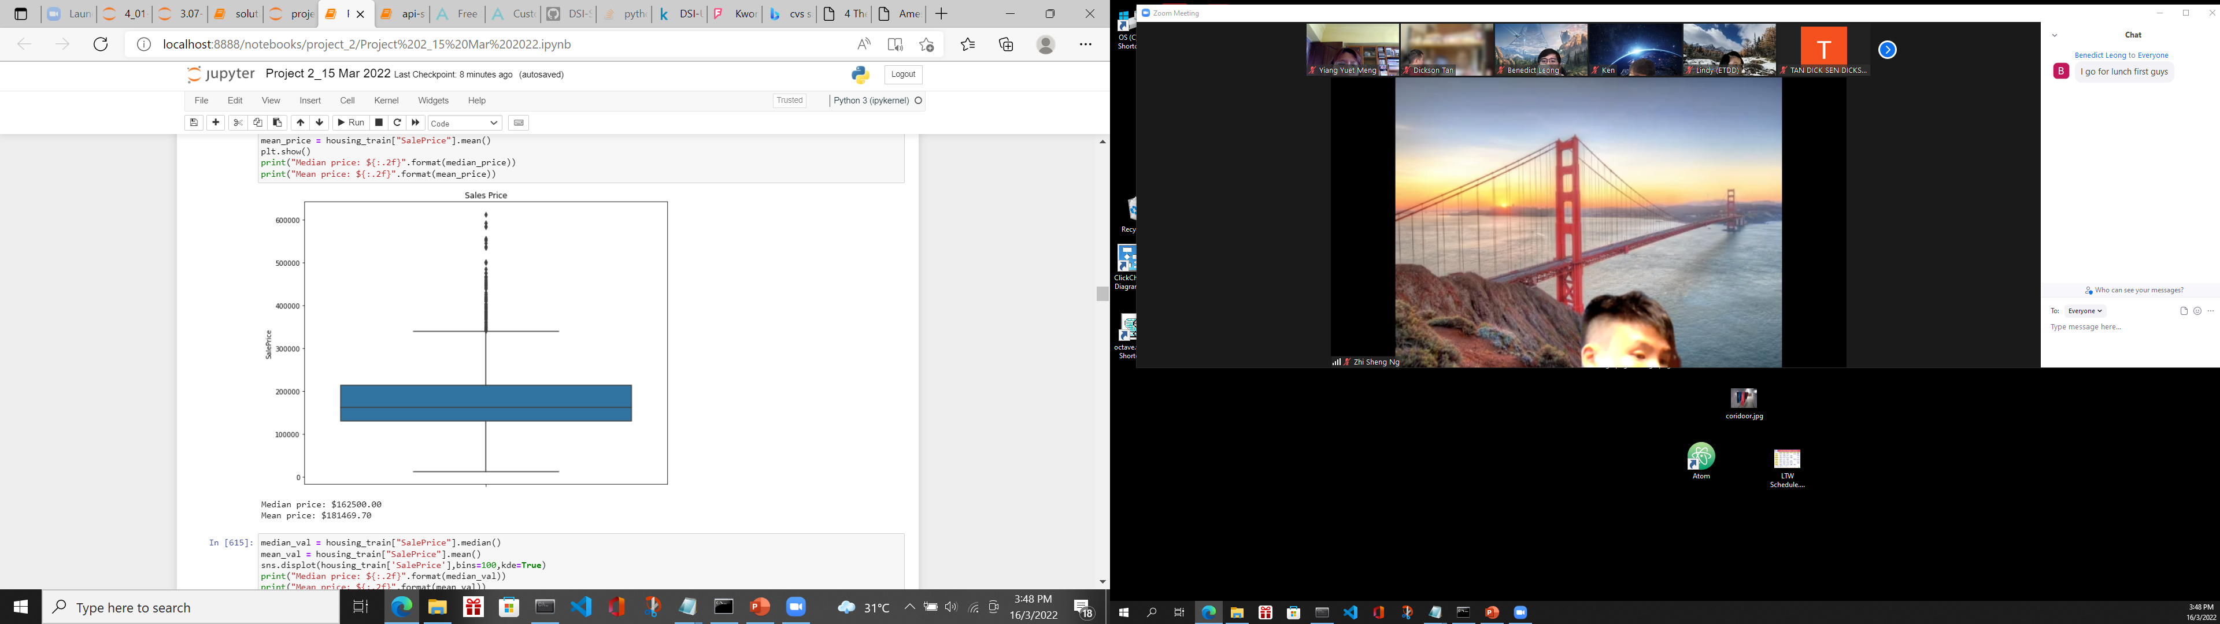
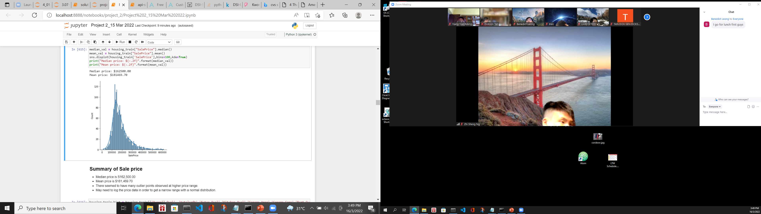
EDA – sale price
Everything looks good here, with no missing values. A tail extends to high prices. There seemed to have many outlier points observed at higher price range. I will log the price data in order to get a narrow range with a normal distribution

Slide 10
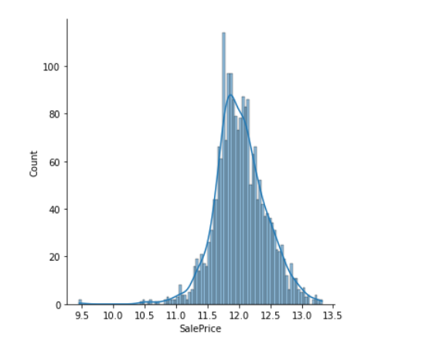
EDA – sale price
After I perform a logarithmic transformation of the Sale Price, it made highly skewed distributions less skewed

Slide 11
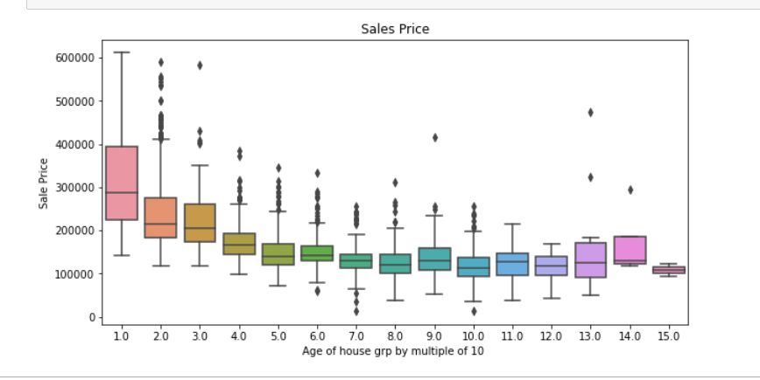
EDA – sale price wrt to age of house
I defined the age of the building as the year of sale minus the year of construction. New houses have a price premium that declines as they age even by 10 to 20 years. After a while the effect of age plateaus off, only to come back for very old houses.

Slide 12

EDA – sale price wrt overall quality
Overall Quality of the houses from one to ten. It turns out they are great predictors of sale price, with higher quality and commanding higher prices

Slide 13
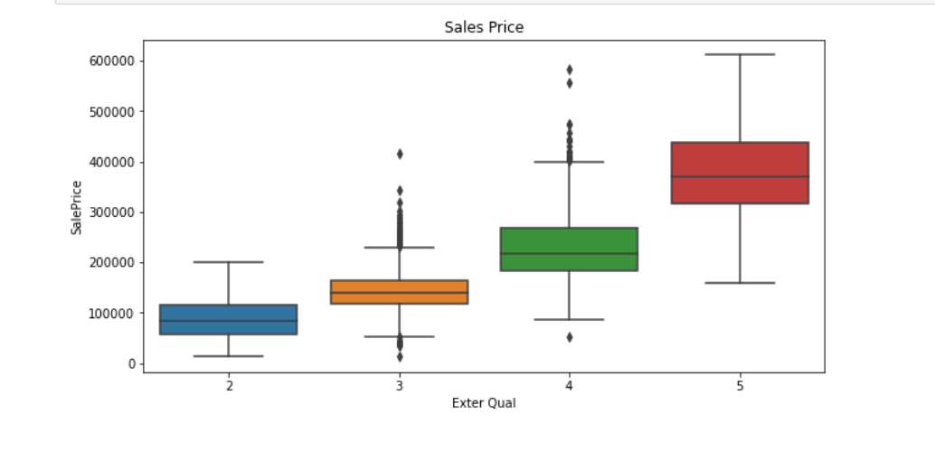
EDA – sale price wrt external quality
External Quality of the houses from one to ten. It turns out they are great predictors of sale price, with higher quality and commanding higher prices

Slide 14
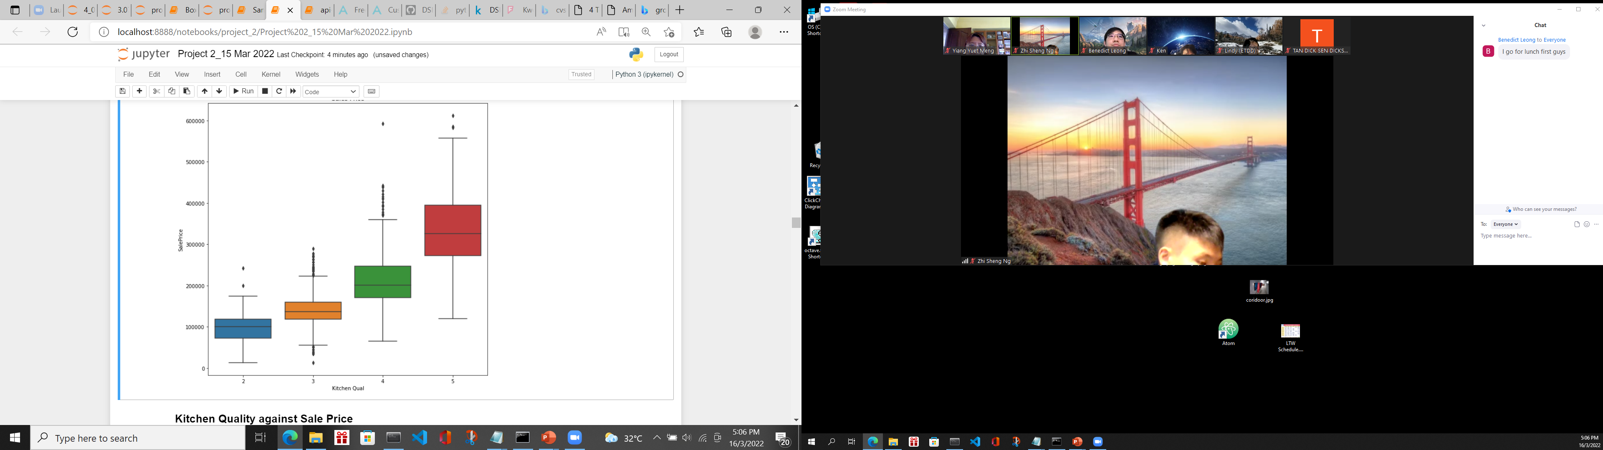
EDA – sale price wrt Kitchen Quality
Kitchen Quality of the houses from one to ten. It turns out they are great predictors of sale price, with higher quality and commanding higher prices

Slide 15
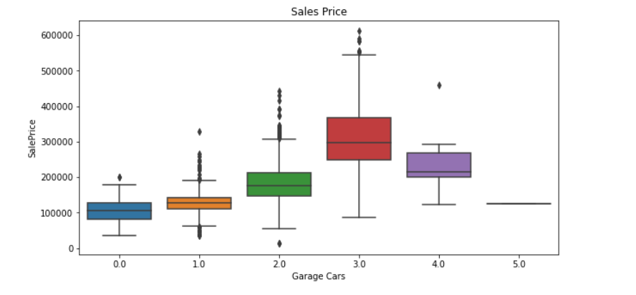
EDA – sale price wrt garage cars
Sale Price increases with the increase in garage cars. Once it reaches 4 Garage cars, the price decreases

Slide 16

EDA – sale price wrt Basement quality
Sale Price increases with the increase in basement quality.

Slide 17
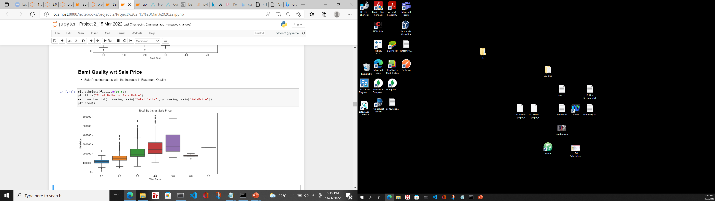
EDA – sale price wrt no of baths
Sale Price increases with the increase in no of baths. When it is beyond 5, it will not have effect on the price

Slide 18
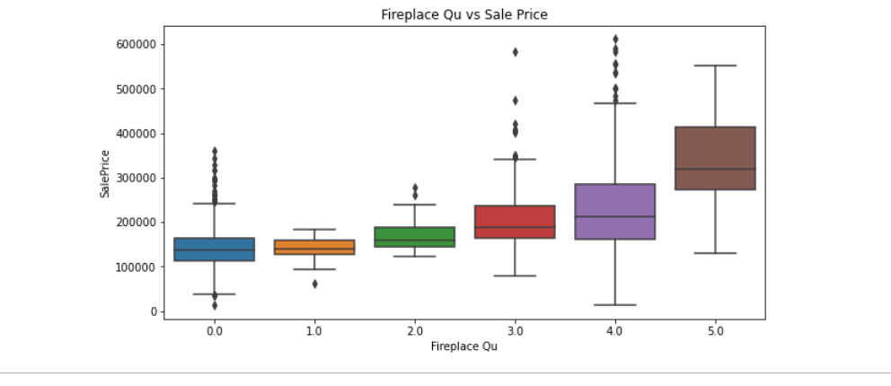
EDA – sale price wrt fireplace quality
Sale Price increases with the increase in Fireplace Quality.

Slide 19
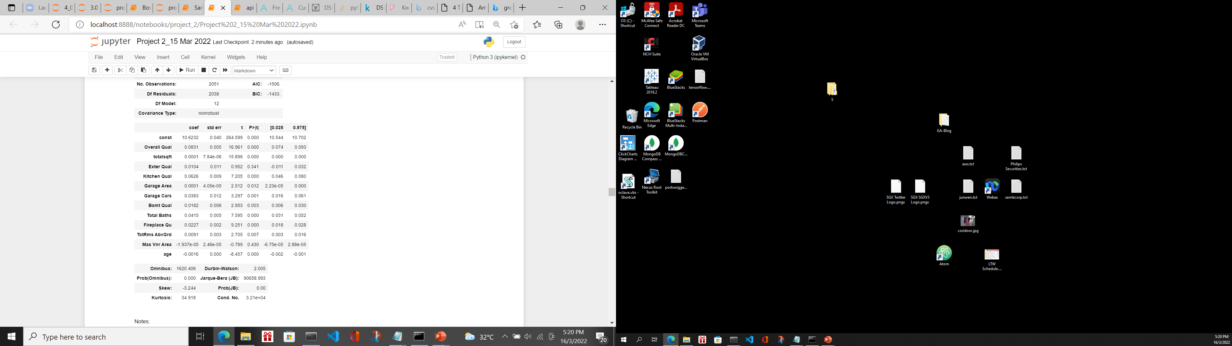
Feature engineering
P Value of 'Exter Qual', 'Mas Vnr Area' are more than 0.05 which is not significant. I decide to remove these features from the mode

Slide 20
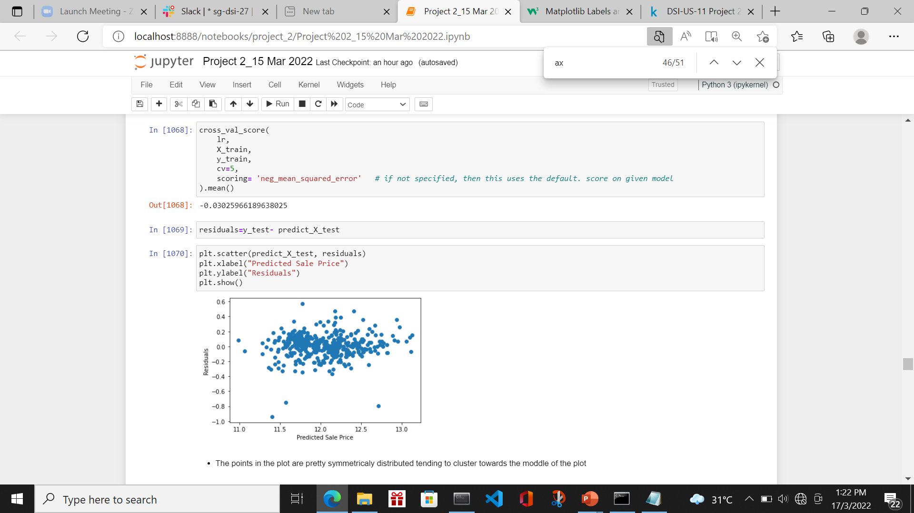
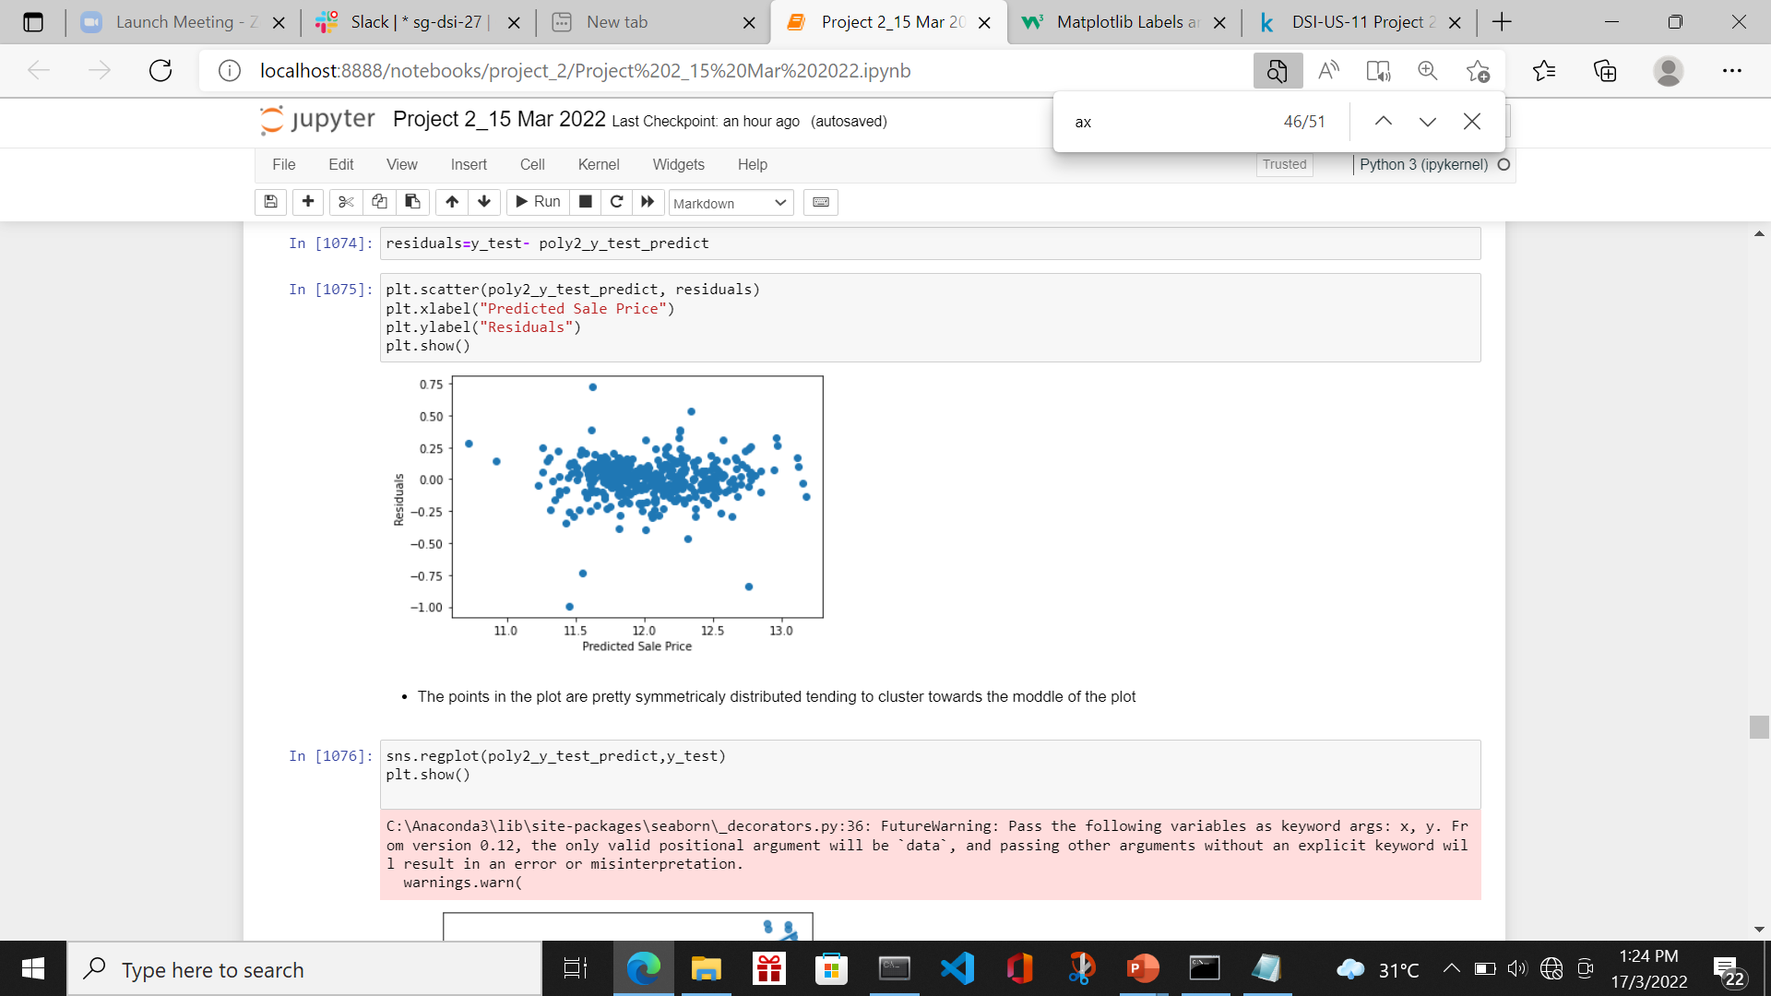
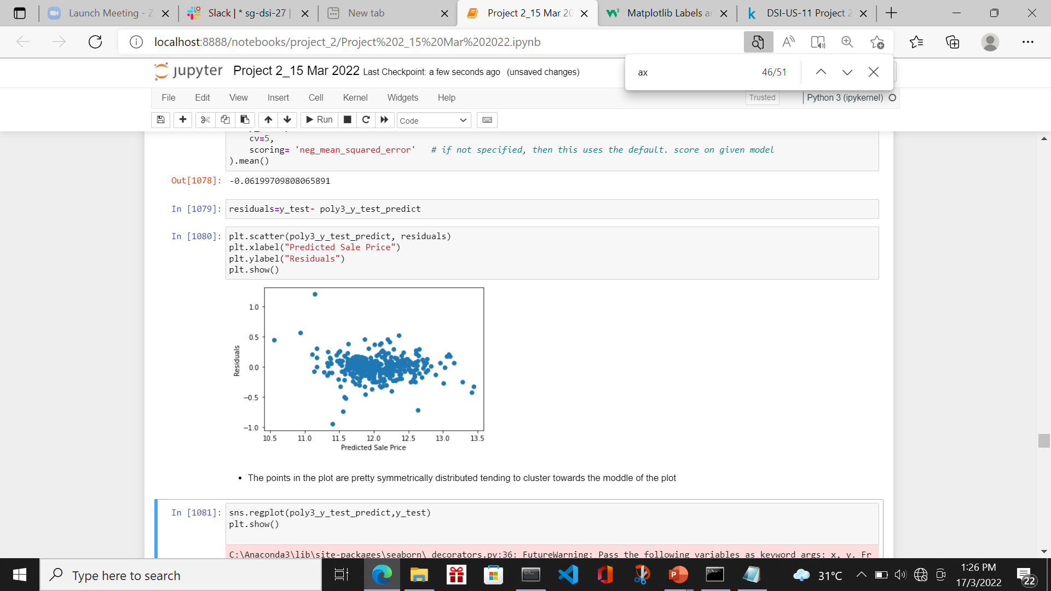
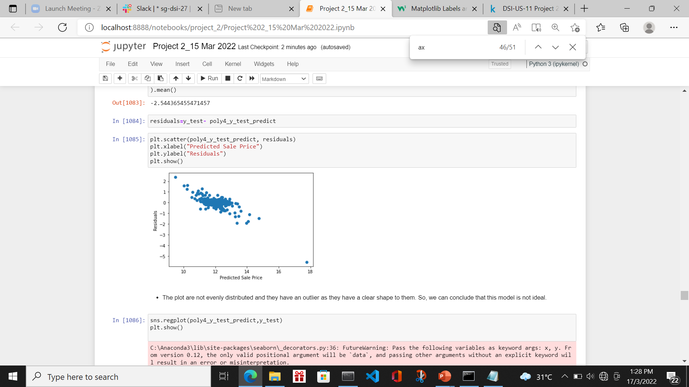
Train/score/evaluate of models
I trained and tested 4 models namely Linear Regression, Ridge Regression, Lasso Regression and ElasticNet Regression with varying Degree. Below is the Linear Regression Result
Model | Degree | Residue vs Predicted Plot | Remark
Linear Regression | 1 |  | The points in the plot are pretty symmetrically distributed tending to cluster towards the middle of the plot
Linear Regression | 2 |  | The points in the plot are pretty symmetrically distributed tending to cluster towards the middle of the plot
Linear Regression | 3 |  | The points in the plot are pretty symmetrically distributed tending to cluster towards the middle of the plot
Linear Regression | 4 |  | The plot are not evenly distributed and they have an outlier as they have a clear shape to them. So, we can conclude that this model is not ideal.

Slide 21
Train/score/evaluate of models
Linear Regression Result
Model | Degree | MSE (train) | MSE (test) | CVS | Remark
Linear Regression | 1 | 0.02871836725337317 | 0.02429025756115978 | 0.03025966189638025
Linear Regression | 2 | 0.02028496 | 0.02406107 | 0.024583811306377802 | Best among Linear Regression
Linear Regression | 3 | 0.01461285 | 0.03120501 | 0.06199709808065891
Linear Regression | 4 | 0.00807620 | 0.21694482 | 2.544365455471457

Slide 22
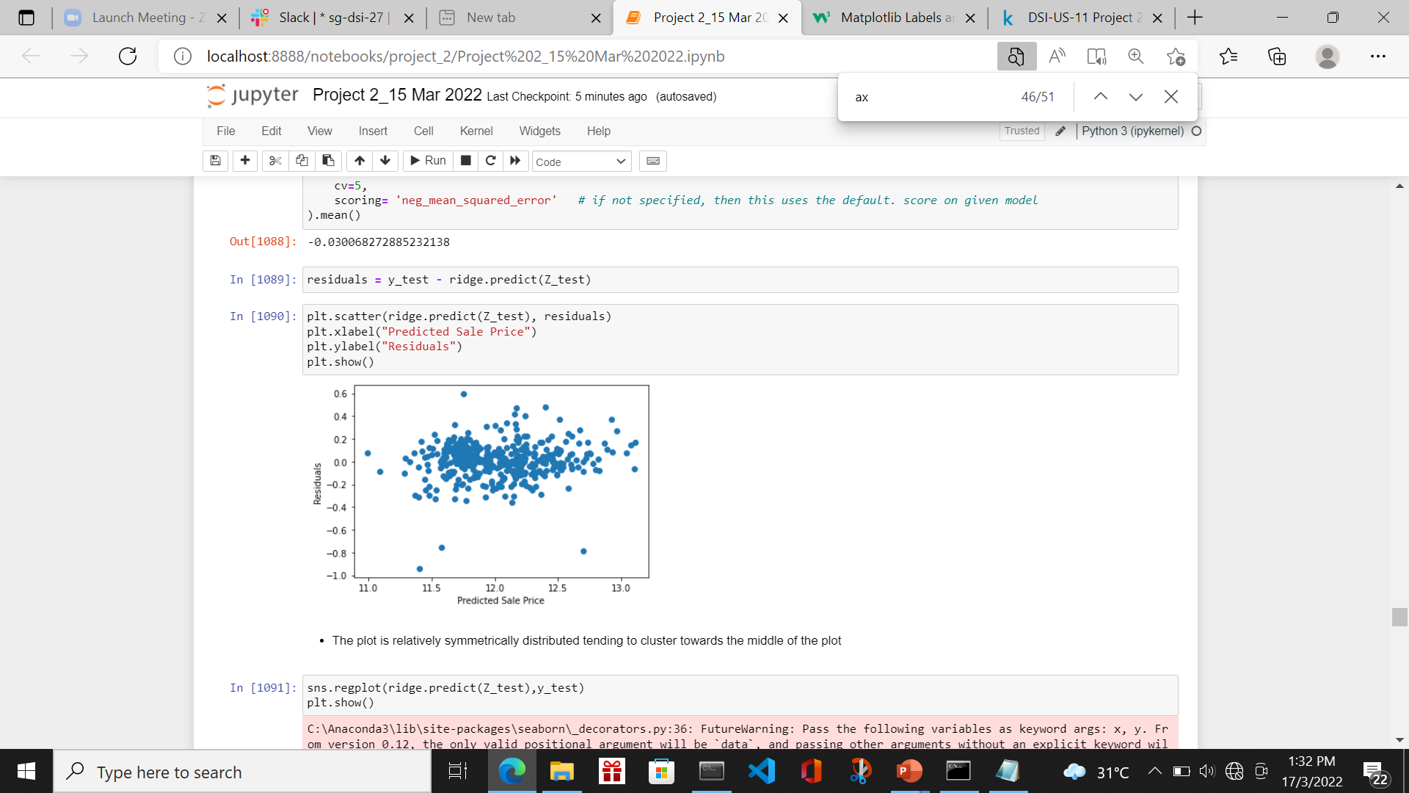
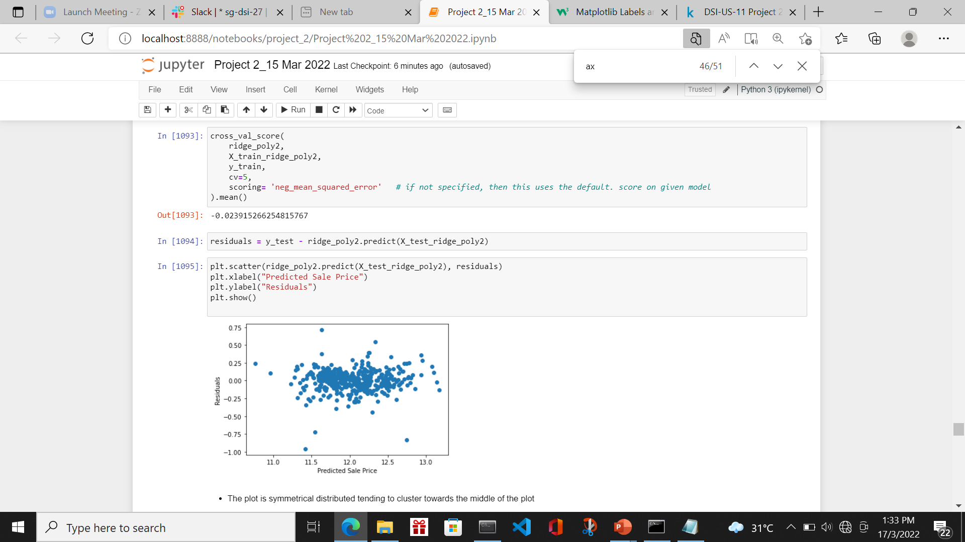
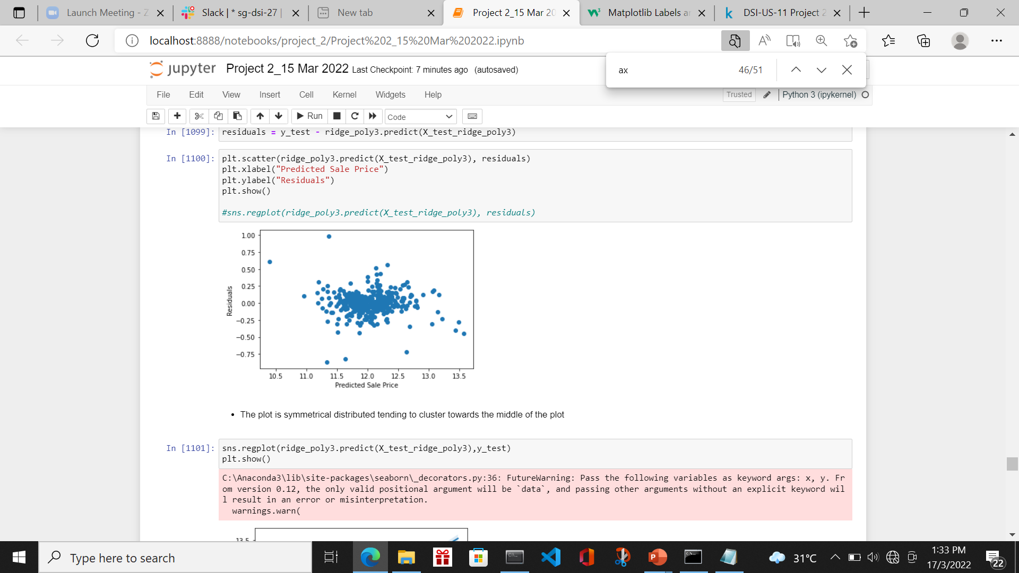
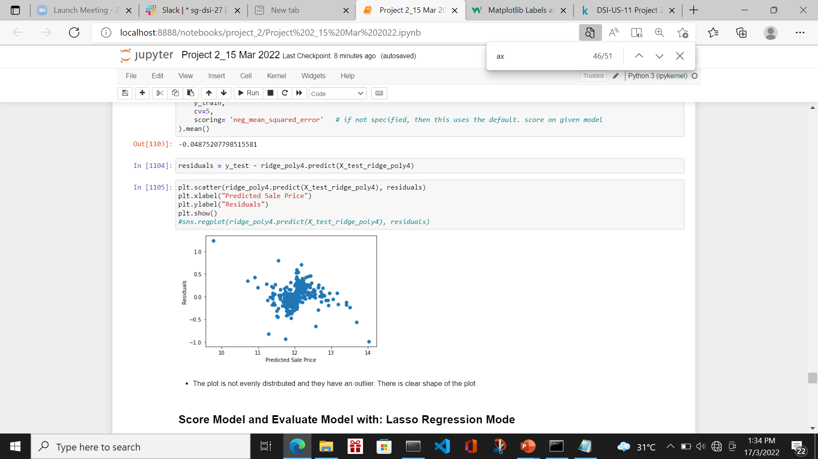
Train/score/evaluate of models
Ridge Regression
Model | Degree | Residue vs Predicted Plot | Remark
Ridge Regression | 1 |  | The points in the plot are pretty symmetrically distributed tending to cluster towards the middle of the plot
Ridge Regression | 2 |  | The points in the plot are pretty symmetrically distributed tending to cluster towards the middle of the plot
Ridge Regression | 3 |  | The points in the plot are not so symmetrically distributed. Model starts to deteriorate.
Ridge Regression | 4 |  | The plot is not evenly distributed and they have an outlier. There is clear shape of the plot.

Slide 23
Train/score/evaluate of models
Ridge Regression Result
Model | Degree | MSE (train) | MSE (test) | CVS | Remark
Ridge Regression | 1 | 0.028831218507909623 | 0.024593535056232775 | 0.030068272885232138
Ridge Regression | 2 | 0.020517549721110532 | 0.023634145039232196 | 0.023915266254815767 | Best Model with lowest CVS among Ridge Regression
Ridge Regression | 3 | 0.01780170233268262 | 0.027336867181414117 | 0.029844168853918728
Ridge Regression | 4 | 0.030844580485791646 | 0.04520048742066716 | 0.04875207798515581 | Residue plot not ideal

Slide 24
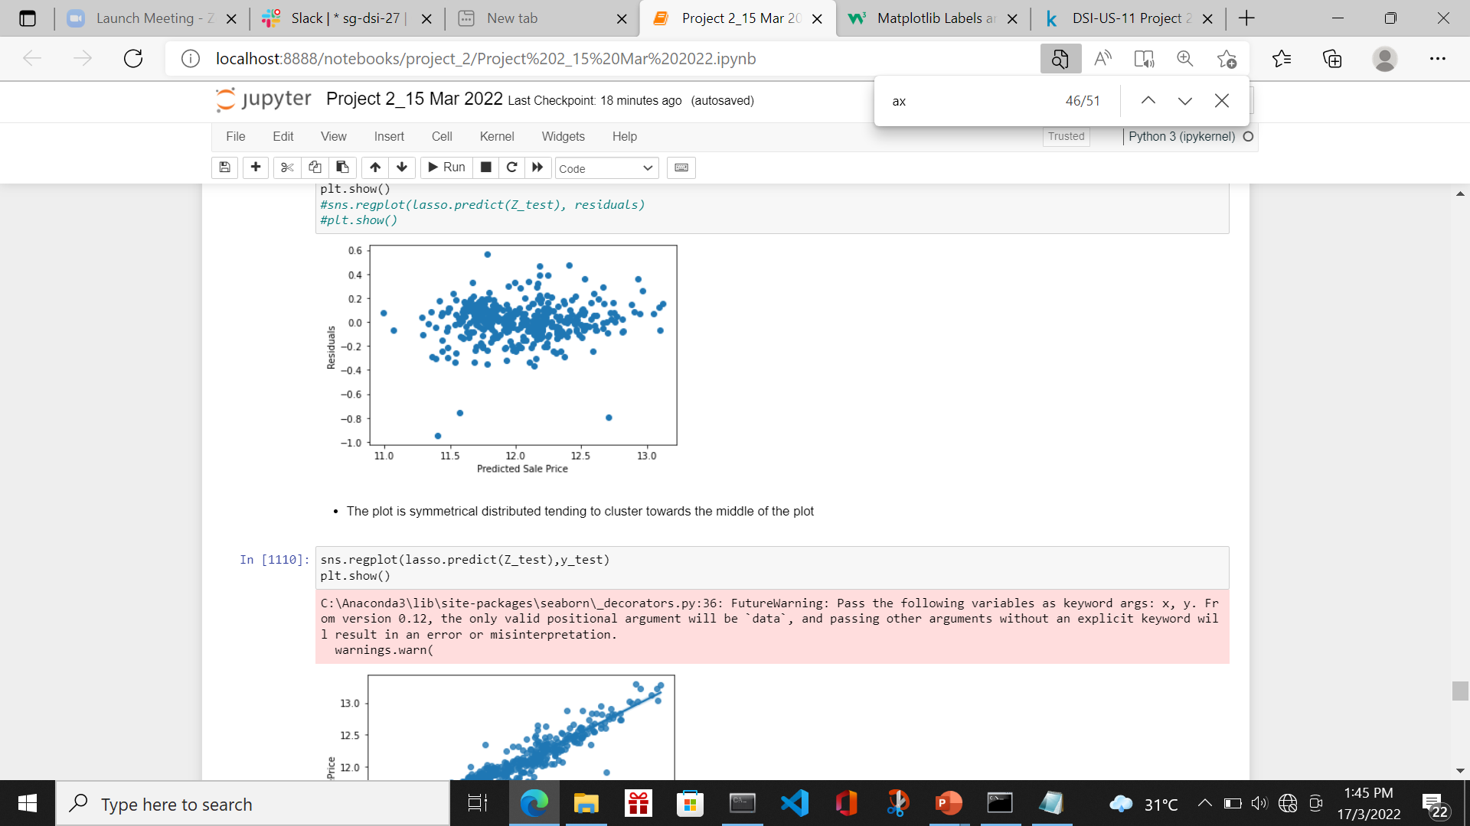
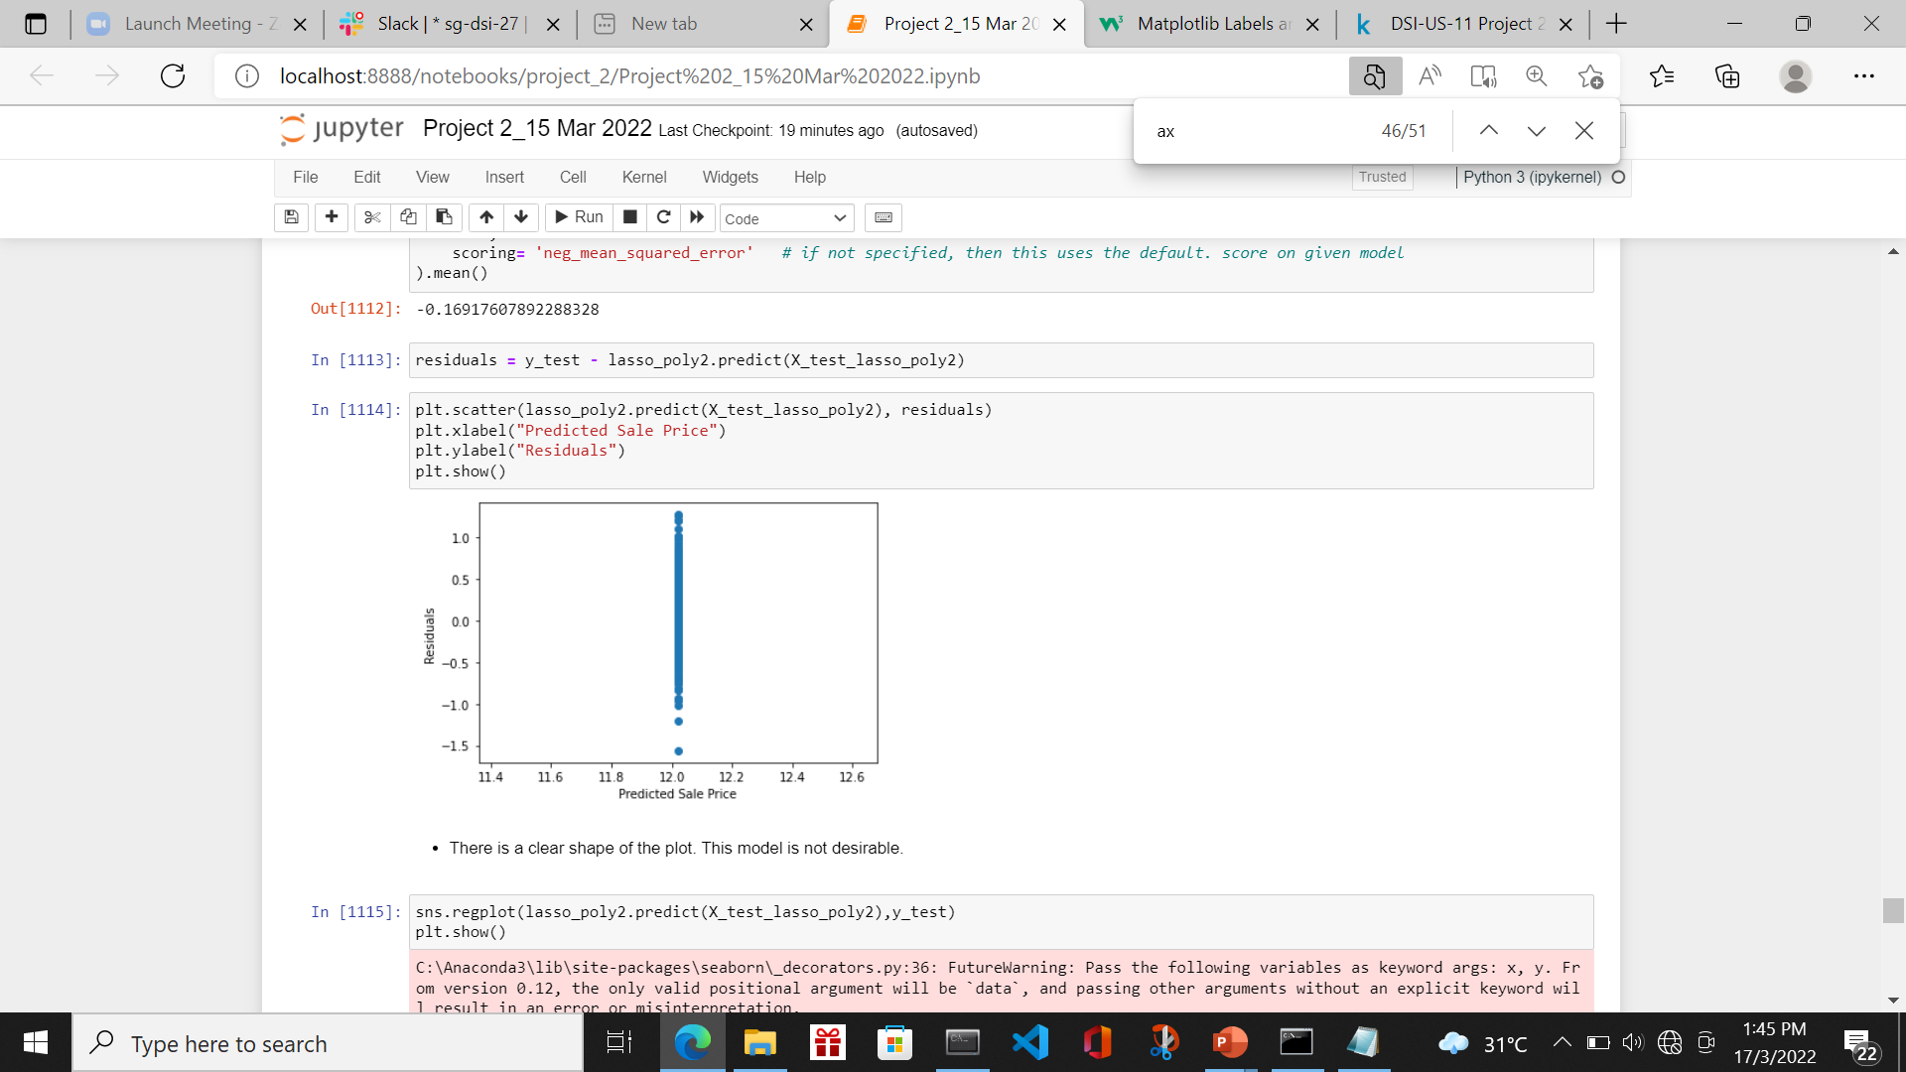
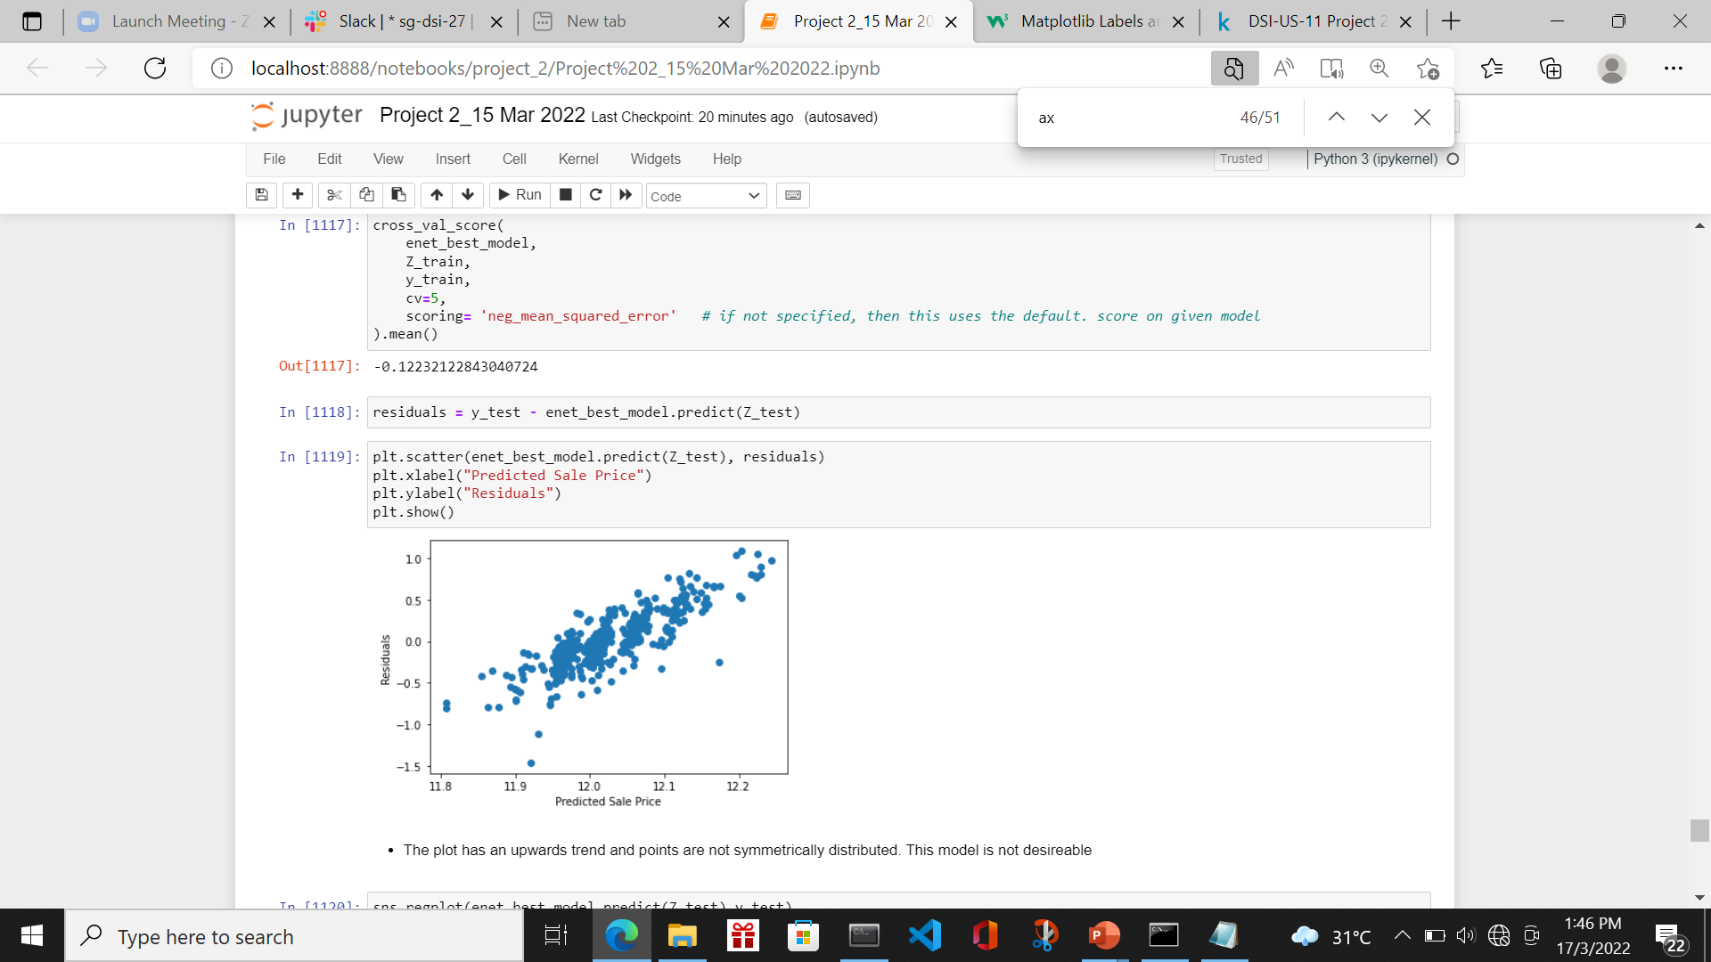
Train/score/evaluate of models
Lasso and ElasticNet Regression Result
Model | Degree | Residue vs Predicted Plot | Remark
Lasso Regression | 1 |  | The points in the plot are pretty symmetrically distributed tending to cluster towards the middle of the plot
Lasso Regression | 2 |  | There is a clear shape of the plot. This model is not desirable
ElasticNet Regression | 1 |  | The plot has an upwards trend and points are not symmetrically distributed. This model is not desirable

Slide 25
Train/score/evaluate of models
Lasso and ElasticNet Regression Result
Model | Degree | MSE (train) | MSE (test) | CVS | Remark
Lasso Regression | 1 | 0.02872769121745429 | 0.024330515185106642 | 0.030251245451425525
Lasso Regression | 2 | 0.16898931570251494 | 0.16958113581952464 | 0.1691760789228832 | Residue plot not ideal Model gets worse
ElasticNet Regression | 1 | 0.1218681398553341 | 0.12175688412319963 | 0.12232122843040724 | Residue plot not ideal Model is not ideal

Slide 26
Train/score/evaluate of models
Shortlisting of the more desirable models
Model | Degree | MSE (train) | MSE (test) | CVS | Remark
Linear Regression | 2 | 0.02028496 | 0.02406107 | 0.024583811306377802 | Best among Linear Regression
Ridge Regression | 2 | 0.020517549721110532 | 0.023634145039232196 | 0.023915266254815767 | Best Model with lowest CVS
Lasso Regression | 1 | 0.02872769121745429 | 0.024330515185106642 | 0.030251245451425525

Slide 27
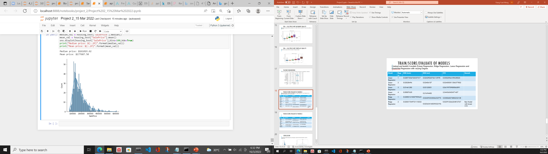
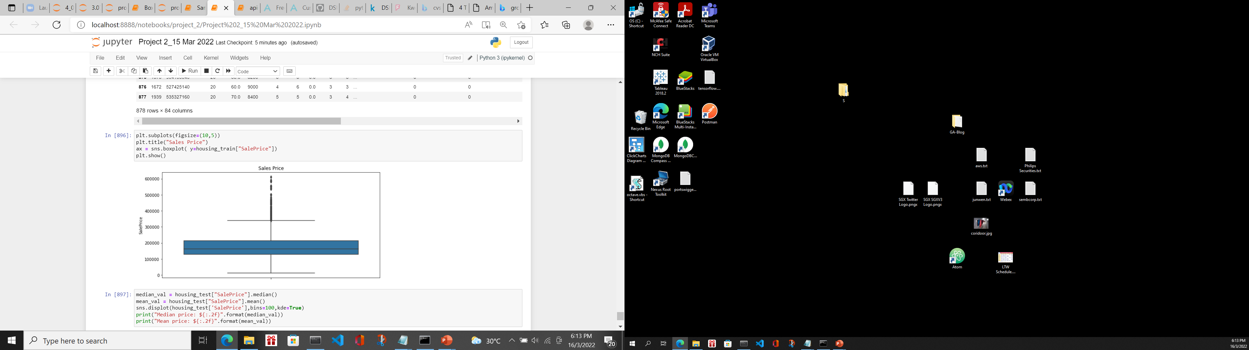
conclusion
I selected the Ridge Regression with Degree 2 alpha=65.79332246575679 with the lowest CVS. The mean price of list of houses is $161,019.62 and the median price is $177,687.50

Slide 28
conclusion
The mean price of list of houses is $161,019.62.
The predictors based on this price are
Fireplace quality is at least 3
No of baths is at least 2
Garage Cars is at least 2
External Quality is at least 3
Kitchen Quality is at least 3
Overall Quality is at least 3
To fetch a higher price, we can improve the External Quality, Kitchen Quality and Overall Quality, Fireplace Quality of the house
Approval to set the predicted price as the baseline price for the houses

